Slide 1

A PRESENTATION FOR
COMMUNITY PARTNERS

Slide 2
THE MISSION
To raise the confidence and aspirations of high school girls by helping them develop the skills required to be leaders in their lives, families, careers, and communities.

Slide 3
THE NEED
Between elementary and high school, the self-esteem of girls drops an average of 3.5 times more than the self-esteem of boys. This decline often leads to disbelief in their math or science aptitude.
As early as middle school, girls are 25% less likely than boys to say they enjoy taking the lead.
Youth who were at risk of falling off track but had mentors were 130% more likely to assume leadership roles in adulthood.

Slide 4
THE PROGRAM
The Institute delivers a three-year, evidence-based program rooted in the themes:
  “MY VALUES” (10th grade)
  “MY VOICE” (11th grade)
  “MY VISION” (12th grade)
Participants, known as “Olympia’s Leaders,” are led through a progressive curriculum designed to achieve seven specific outcomes critical to developing confidence and increasing aspirations.

Slide 5
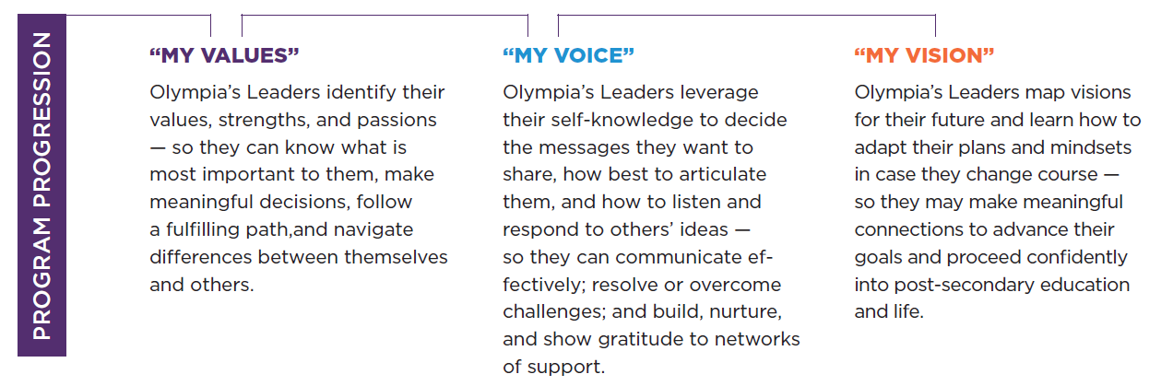
THE PROGRESSION

Slide 6
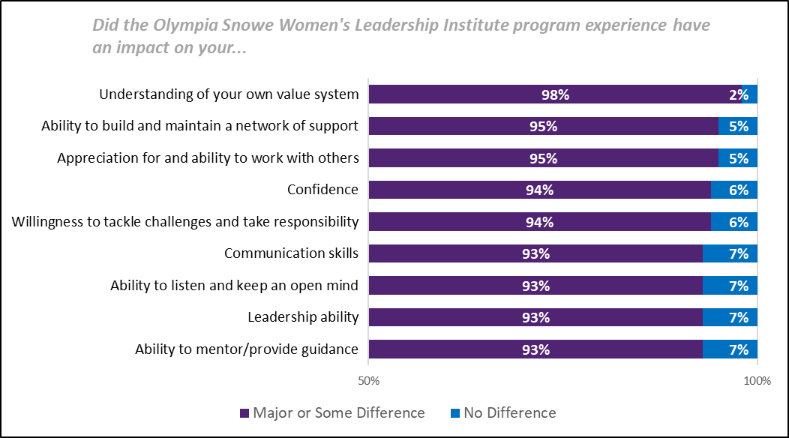
THE OUTCOMES
A compelling testament of the program’s success is that 100% of the Class of 2021 have matriculated to two-and four-year colleges, training or certificate programs, or the military.
  59% are pursing studies in STEM fields and 76% have stayed in Maine.

Slide 7
THE DIVERSITY
In the Class of 2023, 30% identify as a race other than Caucasian.
52% of sophomore Olympia’s Leaders (also Class of 2023) are classified as low- to-moderate income.
Olympia’s Leaders self-report factors related to their identity—gender identity and disability. 17% identify as LGBTQ+ and 17% report a disability that limits significantly one or more life activities (+10% from previous year). Note, 20% of Olympia’s Leaders chose not to answer the question.

Slide 8
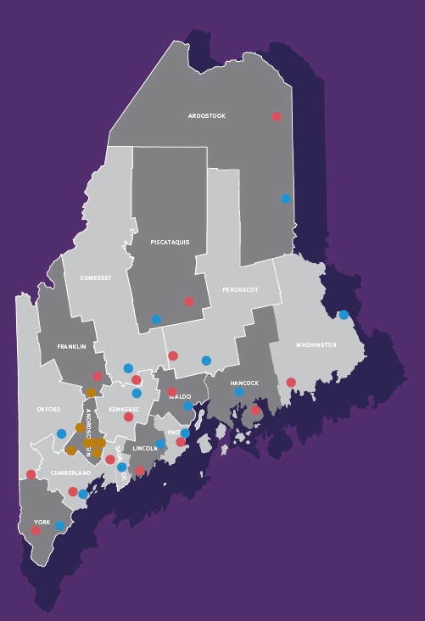

Slide 9
THE SCHOOLS
Bangor High School
Belfast Area High School
Biddeford High School
Boothbay Region High School
Calais Middle/High School
Camden Hills Regional High School
Cony High School
Edward Little High School
Ellsworth High School
Houlton High School
Lawrence High School
Leavitt Area High School
Lewiston High School
Lincoln Academy
Lisbon High School
Medomak Valley High School
Morse High School
Mount Ararat High School
Mount Blue High School
Mount Desert Island High School
Mount View High School
Narraguagus Jr/Sr High School
Nokomis Regional High School
Oak Hill High School
Oceanside High School
Oxford Hills Comprehensive High School
Penquis Valley High School
Piscataquis Community High School
Poland Regional High School
Portland High School
Presque Isle High School
Sacopee Valley High School
Sanford High School
Skowhegan Area High School
Spruce Mountain High School
Westbrook High School
Winslow High School

Slide 10
THE SCHOLARSHIPS
To date, more than 56 Olympia’s Leaders have received scholarships through collaborations facilitated by the Institute to help them realize their educational goals.
*Denotes scholarships available to only Olympia’s Leaders

Slide 11
THE COLLEGE CREDIT
Each year of the Institute’s program represents 30+ contact hours which translate to a digital badge.
Digital badges are well documented, backed by data, confirm proficiency in the skill(s), and are widely recognized by companies hiring today’s employees.
When combined, the three badges translate to the “Olympia’s Leader Alumna” micro-credential, worth three college credits.
Three credits are valued between $350 and more than $2,000 depending on the institution.
As of March 2022, credits are accepted at CMCC, EMCC, KVCC, SMCC, University of Maine, Husson University, and Thomas College.

Slide 12
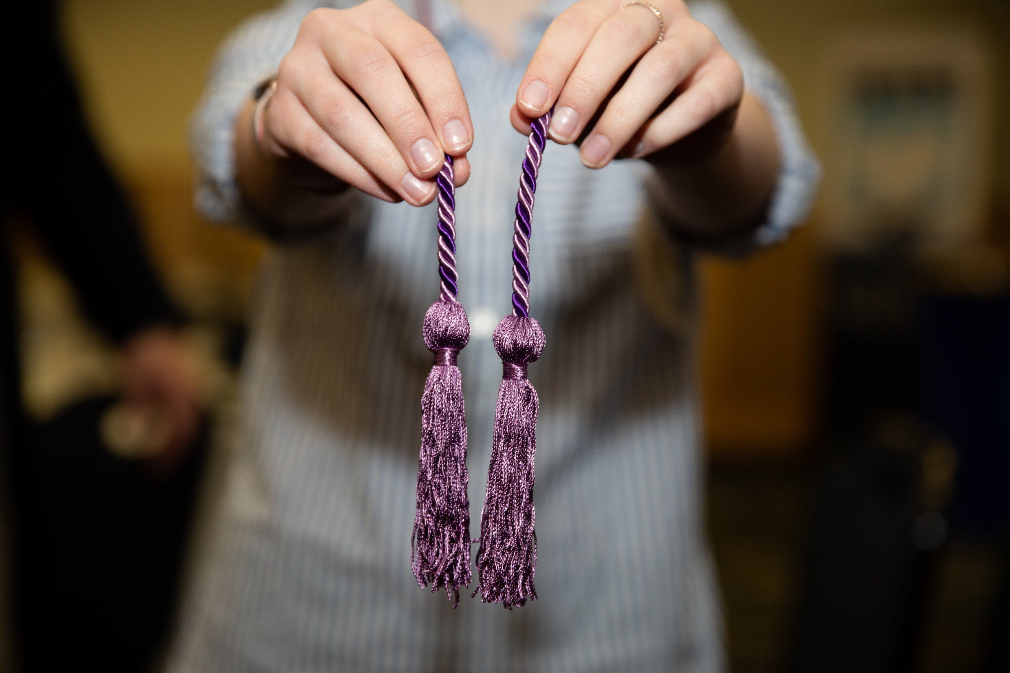
“The program helped me realize what is important to me and what I value; it taught me how to envision a future that embodied those values.”
— Brianna Q., Olympia’s Leader

Slide 13
THE PARTNERSHIP
Partnership Level | Leaders Network 3-4 Events Annually | Donor Reception August 2, 2022 | Leadership Luncheon November 16, 2022 | Marketing Visibility Year Round
Olympia’s Circle $150,000+ | 8 female leaders may participate. Membership includes in-person and virtual programming. | Reception for community partners at The Woodlands Club, Falmouth ME | VIP table of 10 Complimentary Tickets + VIP Pre-Reception in advance of the Luncheon | All communication vehicles—including website, event marketing, statewide advertising, + annual report
Visionaries $15,000 - $149,999 | 6 female leaders may participate. Membership includes in-person and virtual programming. | Reception for community partners at The Woodlands Club, Falmouth ME | VIP table of 8 Complimentary Tickets + VIP Pre-Reception in advance of the Luncheon | All communication vehicles—including website, event marketing, statewide advertising, + annual report
Innovators $5,000 - $14,999 | 4 female leaders may participate. Membership includes in-person and virtual programming. | Reception for community partners at The Woodlands Club, Falmouth ME | 6 Complimentary Tickets + VIP Pre-Reception in advance of the Luncheon | All communication vehicles—including website, event marketing, statewide advertising, + annual report
Leaders $2,500 - $4,999 | 2 female leaders may participate. Membership includes in-person and virtual programming. | Reception for community partners at The Woodlands Club, Falmouth ME | 4 Complimentary Tickets | All communication vehicles—including website, event marketing, statewide advertising, + annual report
Catalysts $1,000 - $2,499 | 1 female leader may participate. Membership includes in-person and virtual programming. | Reception for community partners at The Woodlands Club, Falmouth ME | 2 Complimentary Tickets | Annual Report listing and on select communication vehicles—website, event marketing, statewide advertising
Advocates $500 - $999 | 1 female leader may participate. Membership includes in-person and virtual programming. |  |  | Annual Report listing and on select communication vehicles—website, event marketing, statewide advertising
Friends Up to $499 |  |  |  | Listing in the annual report

Slide 14
THE LEADERS NETWORK
The Leaders Network is a women’s leadership group exclusive to donors of the Institute.
This dynamic group of more than 300 individuals represents various career and life-paths.
Members participate in complimentary professional and personal development, and networking workshops, and serve as role models to Olympia’s Leaders and volunteers at select program activities.
The Leaders Network creates a meaningful link between the Institute’s work with Maine high school girls and the organizations and individuals that ensure the program remains at no cost to program participants and their schools.
Leaders Network participation is voluntary.
Members are invited to complimentary events; however, there is no obligation to attend.
Designees of an organization may be adjusted at any point throughout the year and members may gift their event invitation to another female within their organization if scheduling conflicts arise.

Slide 15
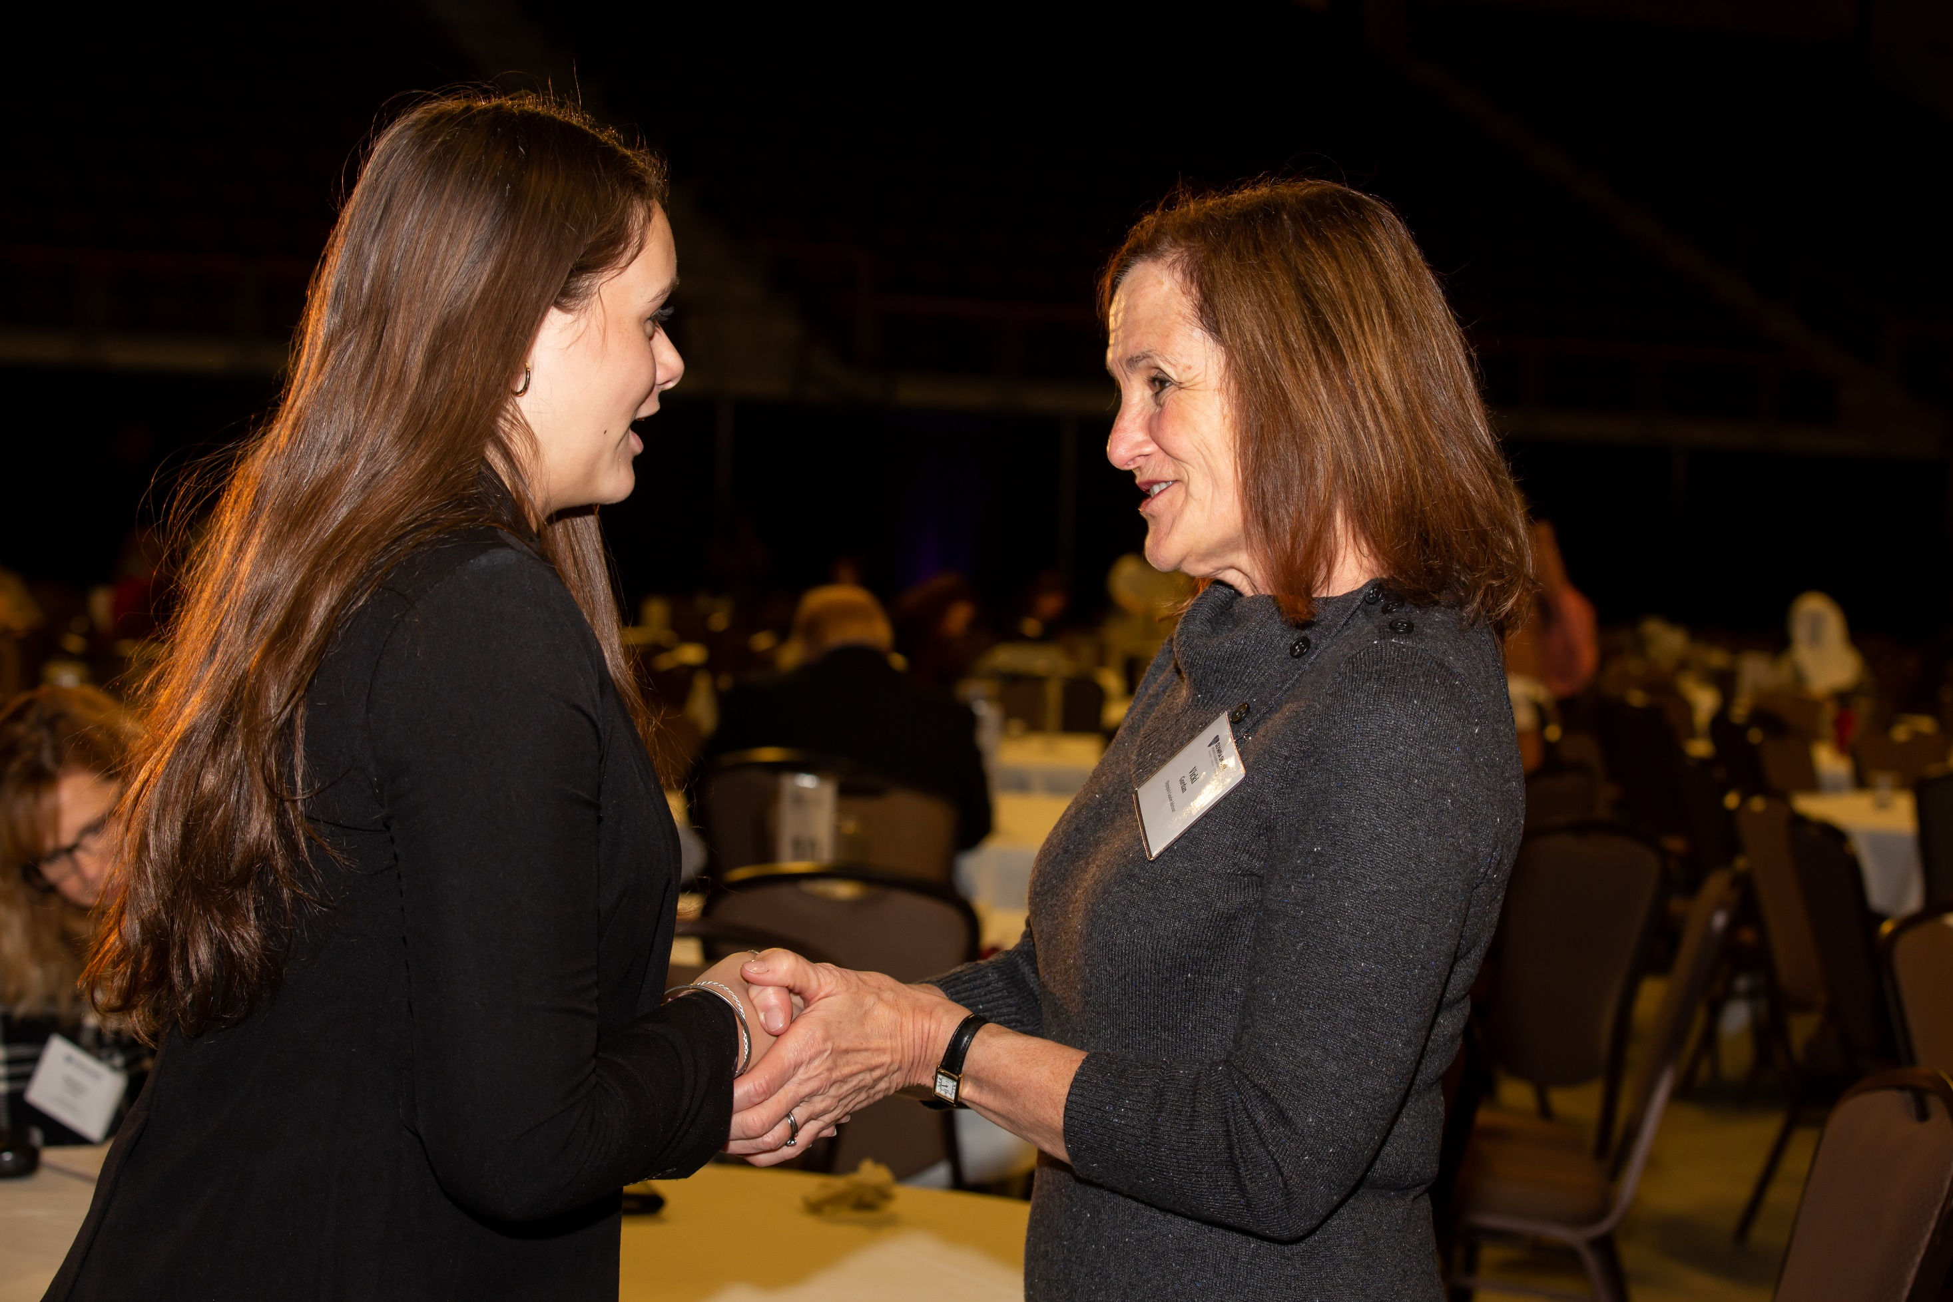
“I am beyond thankful for this community of women who have opened my eyes to the things I can achieve, the woman I want to become, and the life I want to live.”
— Adria P., Olympia’s Leader

Slide 16
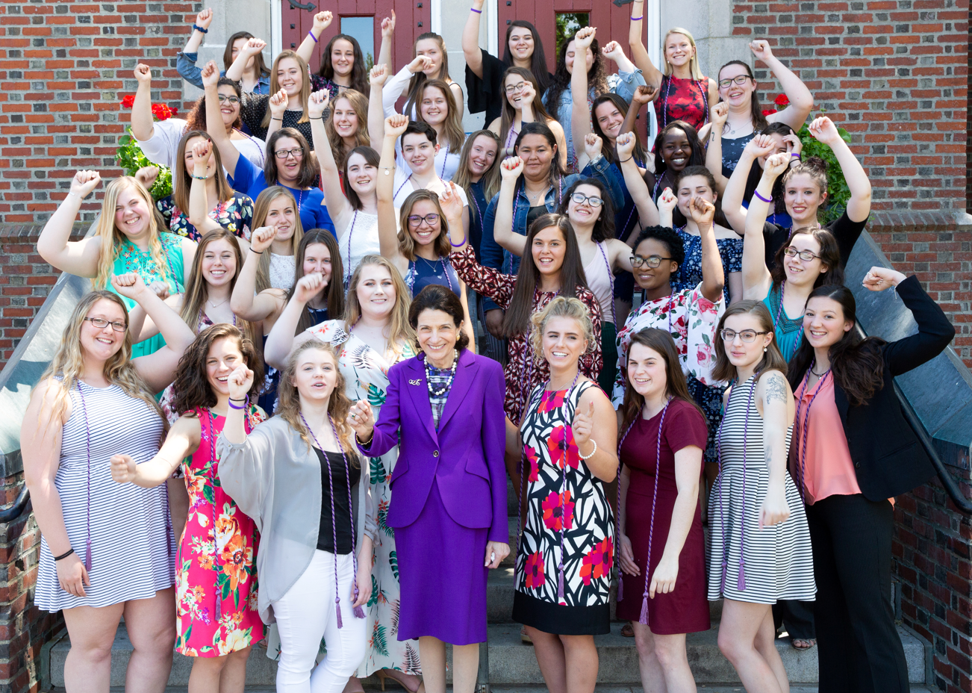
www.snoweleadershipinstitute.org

